Slide 1
HTML5 + CSS3 Blog Sample

Slide 2
HTML5
New elements with added semantics
Easier for search engines to navigate
Drawing graphics on screen
Storing data offline
Drag & Drop
Video support

Slide 3
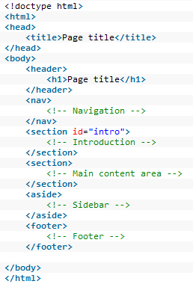
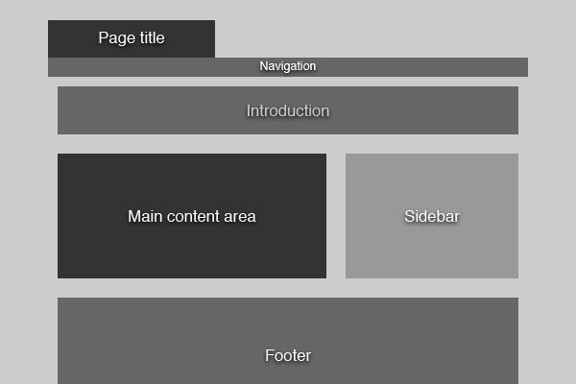
Page Structure in HTML5
In old versions of HTML we used <div> to contain different sections. The new semantic tags
makes it easier for search engines to figure out the page structure
Browser Page Title
1.Html

Slide 4
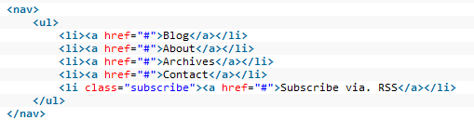
Navigation
As in HTML4 or XHTML – we create a navigation as an unordered list.
2 Navigation.Html

Slide 5

Introduction
We add an id for this section, as we will modify its style later.
Notice we use a header tag to describe the content of sections
3 Introduction.Html

Slide 6
Main Content Area
Contains 3 sections
Blog post
Comments
Comment form
4 MainCont.Html

Slide 7
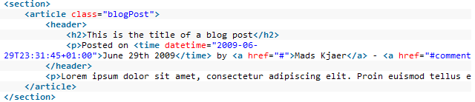
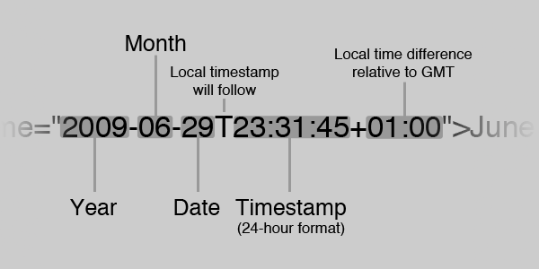
Main Content – Blog Post
<article> tag
denote an independent entry in a blog, discussion, encyclopedia, etc. Each Post will reside inside a separate article tag
Inside <header> we tell the user who posted, when, and how many comments
<time> tag:

Slide 8
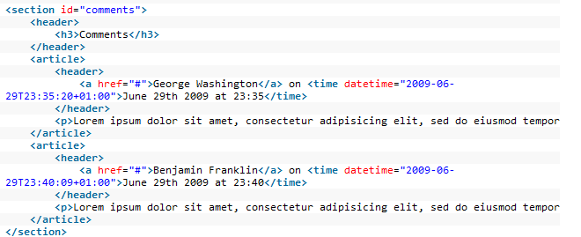
Main Content - Comments
Nothing new here…

Slide 9
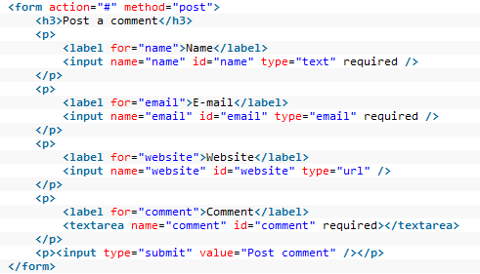
Main Content – Comment Form
Using HTML5 validation of required fields, emails, etc

Slide 10
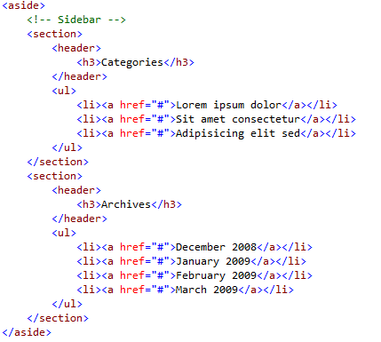
aside area
2 sections will reside as a side content in our blog:
Categories
Archives

Slide 11
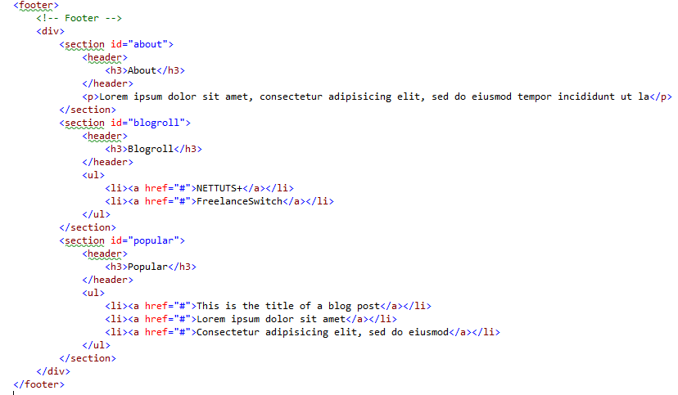
footer area
Contains 3 sections in our blog:
About
Blogroll
Popular
4 MainCont.Html

Slide 12
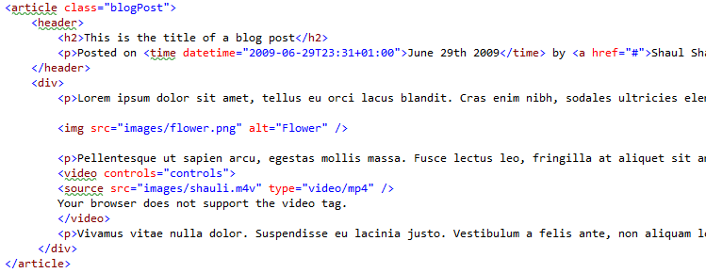
Adding Images and Videos
HTML5 support video tags
We add an image and a video to the blogpost
Videos support Ogg, Mp4 & WebM formats
<audio> tags also exist, and support Wav, MP3, Ogg
5 Image.Html

Slide 13
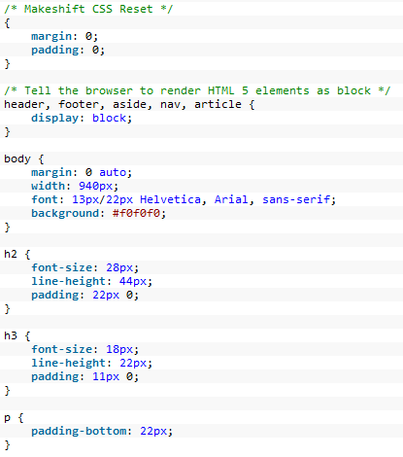
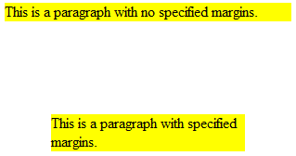
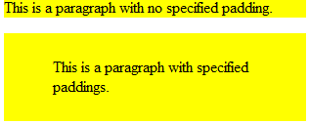
CSS 3 Styling
*
Reset all margins and paddings
We tell the browser to render our HTML5 tags
as blocks till the standard is finally approved
Play with line heights
6 CSS Basis.Html

Slide 14


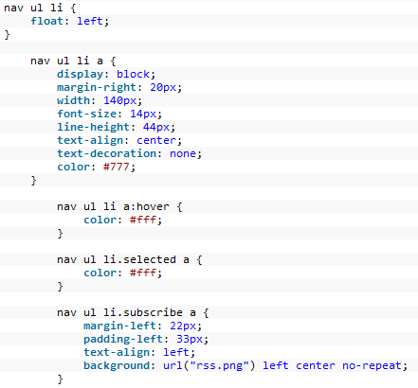
Navigation CSS
Set position to absolute left = 0 and a background image
The nested list is set within the layout
Highlight selected page, hovering
Special style for RSS link with icon
7 CSS Nav.Html

Slide 15

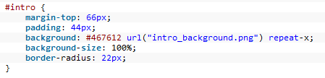
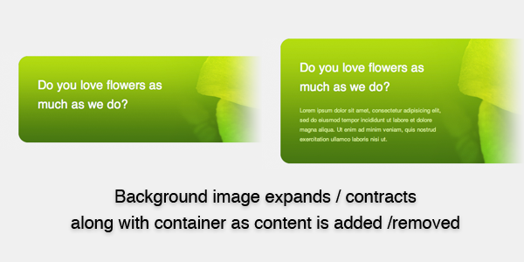
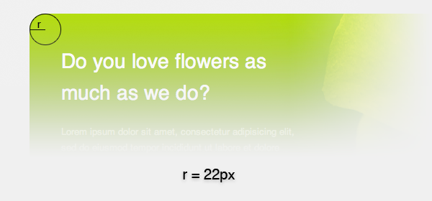
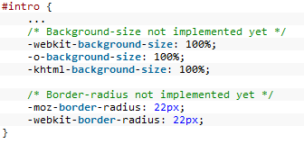
Intro CSS 3
In the intro element in Html, we add an image:
<img src="images/intro_shauli.png" alt="Shauli" />
Scales Background image
For browsers that don’t support it:
Border radius

Slide 16
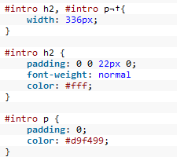
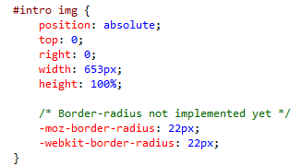
Intro CSS 3
Style the headings and paragraphs
Supporting a second image
8 CSS Intro.Html

Slide 17
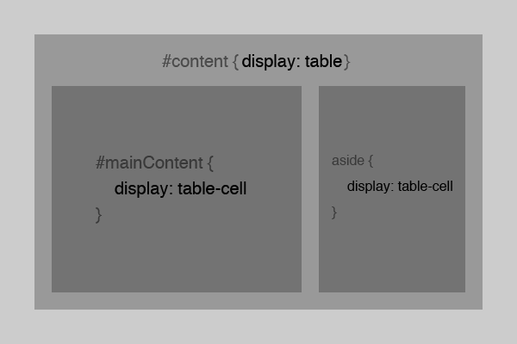
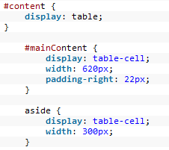
Content Area & Sidebar
In CSS3 we can make elements behave like tables without it ever showing in the markup!
More about Display in CSS3

Slide 18
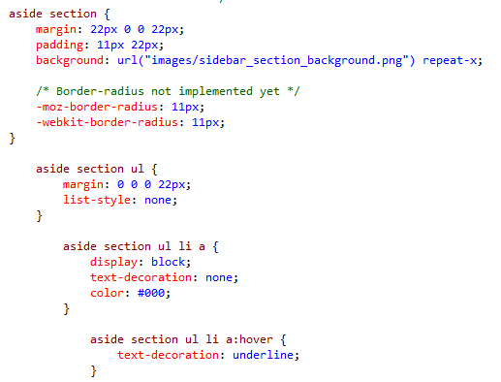
SideBar design finalizing
9 CSS Content Sidebar.Html

Slide 19

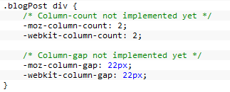
BlogPost CSS 3
Create multiple columns of text:
For now it’s only supported in Firefox so we’ll use:

Slide 20
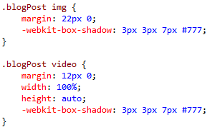
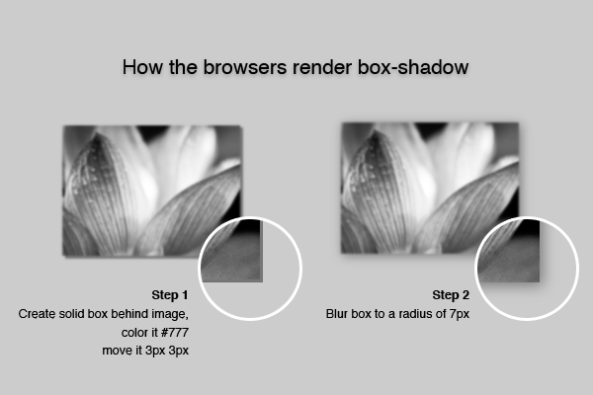
BlogPost Box Shadow
We add a box-shadow for the image and the video, and set the video size:
10 CSS BLOGPOST.Html

Slide 21
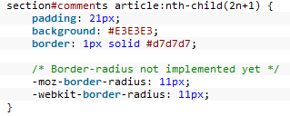
Comments zebra-striping
Easily done! Without Javascript using CSS3 nth-child pseudo class
11 CSS Zebra.Html

Slide 22
Exercise
Explore the CSS style changes for
Comments submit form
Footer

